Slide 1
Searching with Elan

Slide 2
Principles
Elan has four means for searching data:
Searching and replacement within the current file
Searching and replacement within multiple files
Simple search within multiple files
Structured search within multiple files
Replacement within the current file can be undone
Replacement within a set of files cannot be undone. Save your set of files before experimenting with changes.

Slide 3
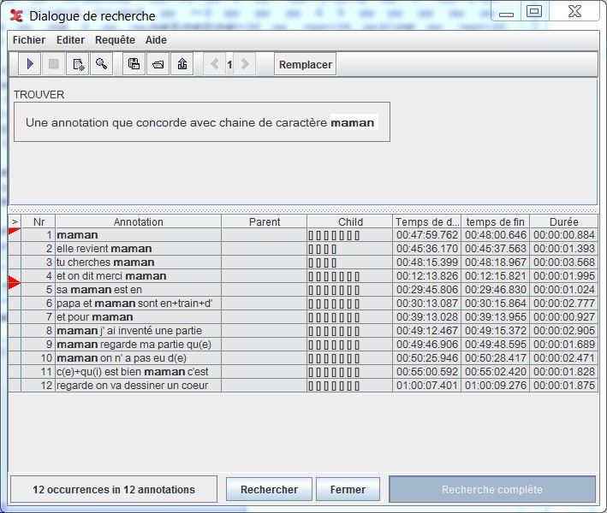
Searching within the current file
Basic function
Looking for an element within all the fields of the transcription
Can limit to a tier or a set of tier
Looking for a regular expression
Click on the result show the corresponding element in the transcription
It’s possible to replace elements
Searches can be saved and exported in csv format (for EXCEL)

Slide 4
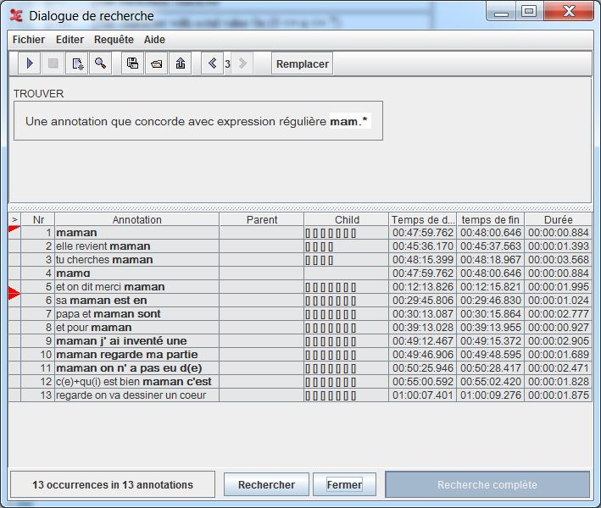
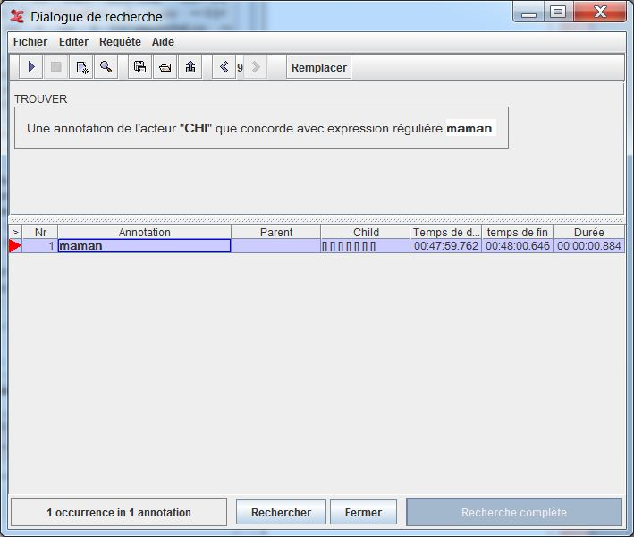
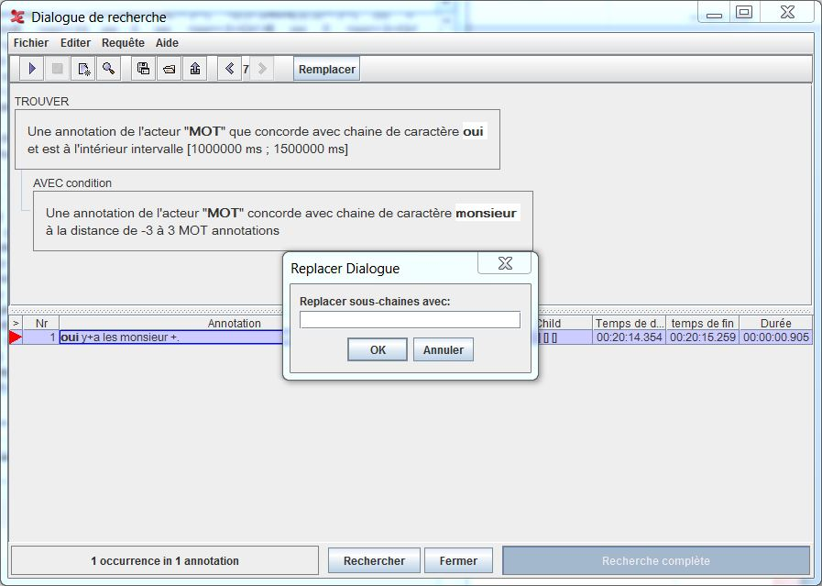

Slide 5
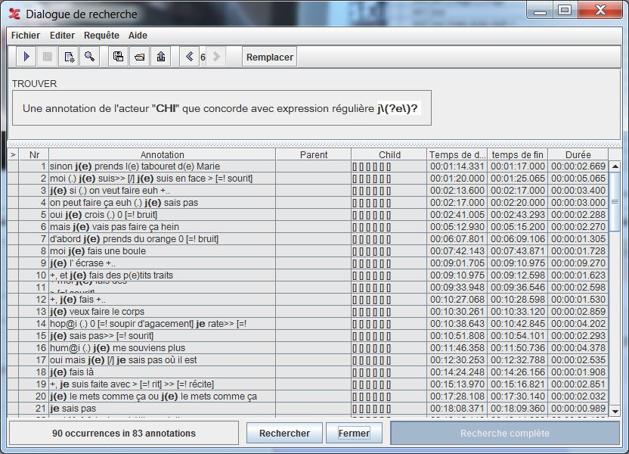
Regular expression example
Looking for the word je for Madeleine at 3 years 9 months:
je is found 17 time
the je with elision of schwa coded j(e)
j\(?e\)? is found 90 times
Adding a new condition: followed by the word fais

Slide 6
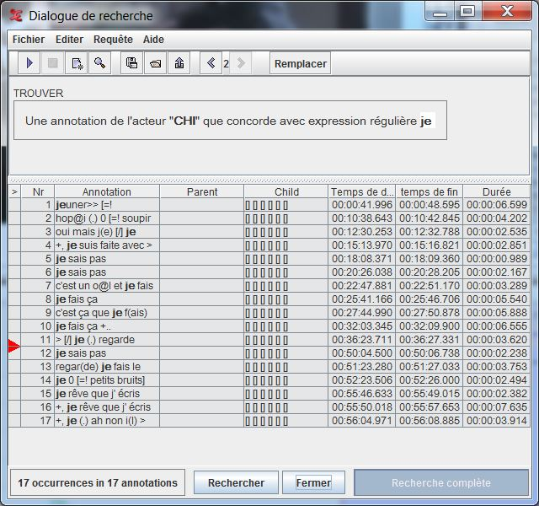
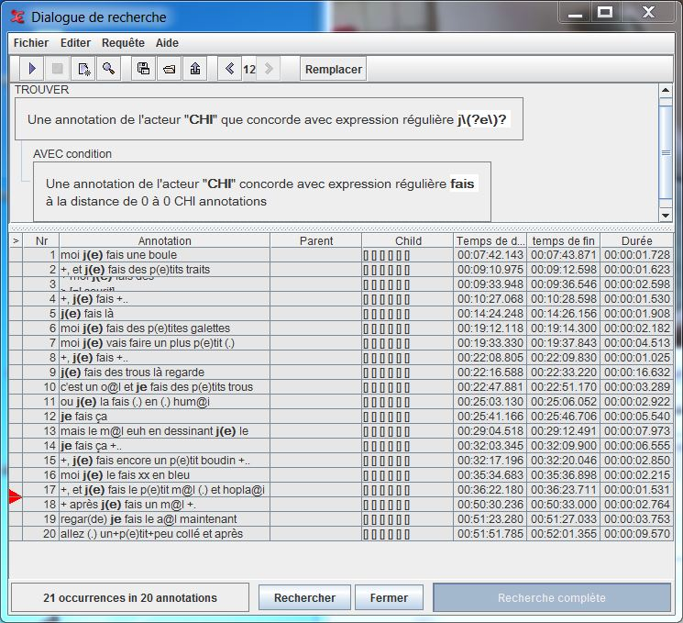

Slide 7
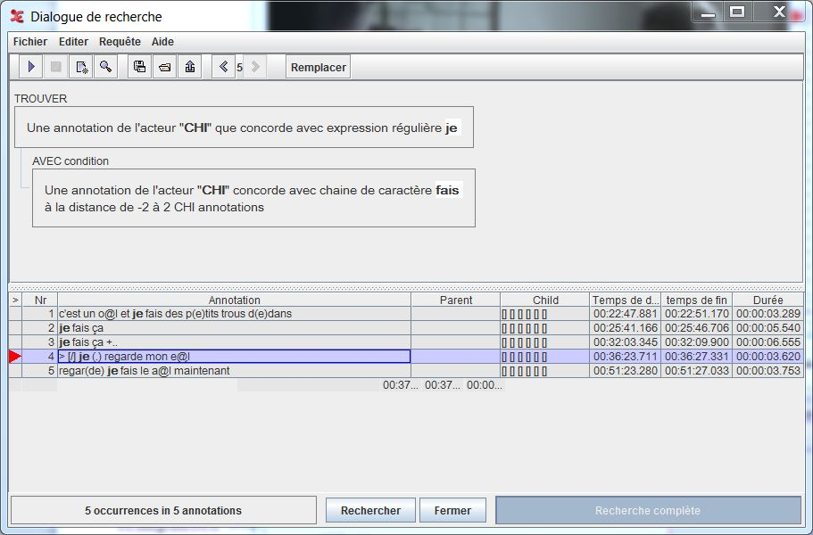
Other search parameters
Search parameter can be modified with temporal information
Multiple criteria can be
controlled with temporal
information
at some temporal distance
with or without overlap
or structural
- à condition que des
templates soient définis
- ou dans les acteurs
principaux avec une distance
structurale

Slide 8
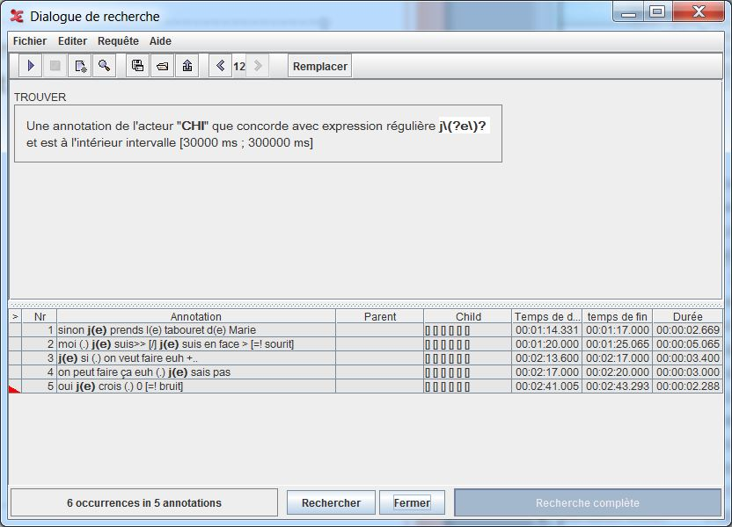
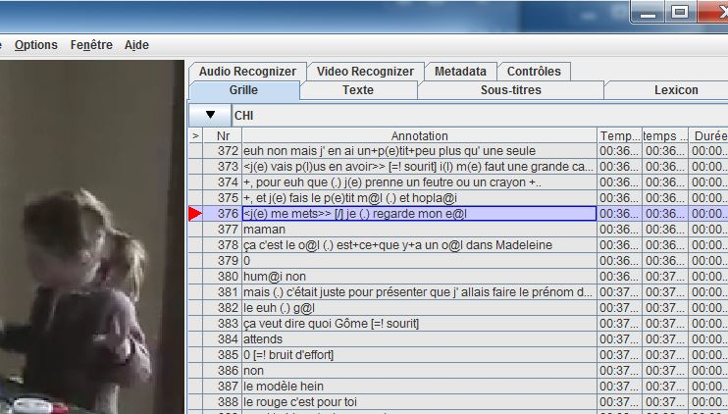

Slide 9
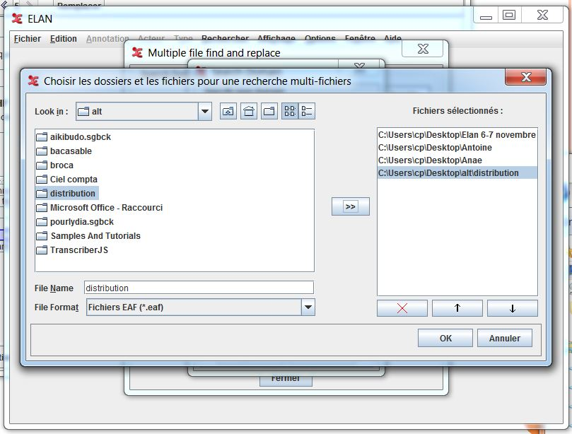
Search domain
The search tools 2, 3 and 4 use the notion of domain
It’s a set of specific files selected using a tool in ELAN

Slide 10
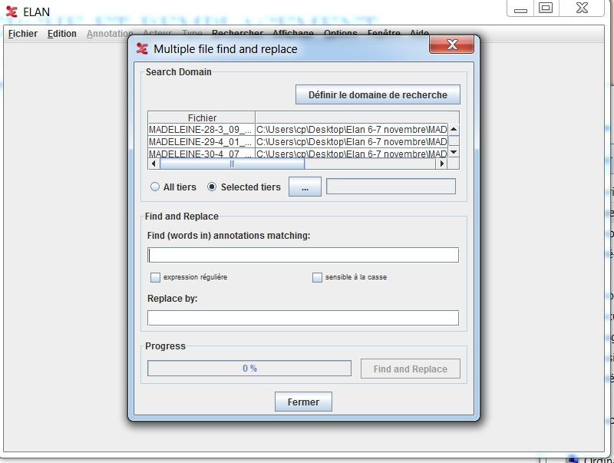
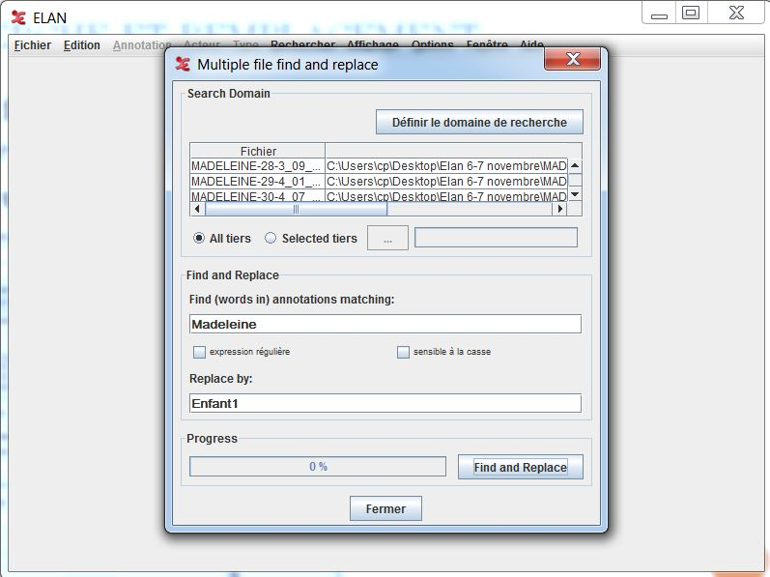
Search and replace
This tool replace all occurrences of a string by another value.
It is possible to limit to a tier or to use regular expressions

Slide 11
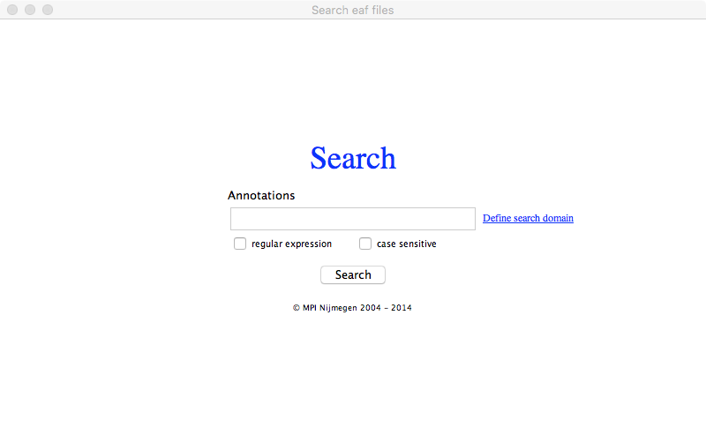
Simple search through many files: The concordancer
Use the menu « Search » then « Search multiple EAF »
Do not forget to set up the search domain
Provide a item with or without a regular expression
It is not possible to
limit to a single tier
It is possible to go
directly
from the results to the
corresponding
transcription

Slide 12
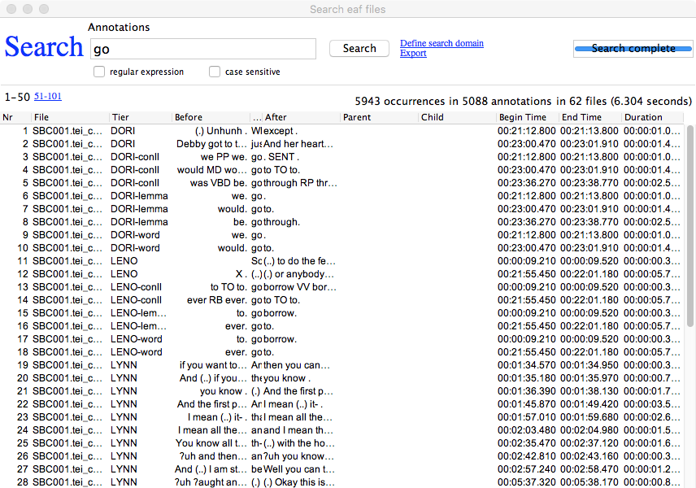

Slide 13
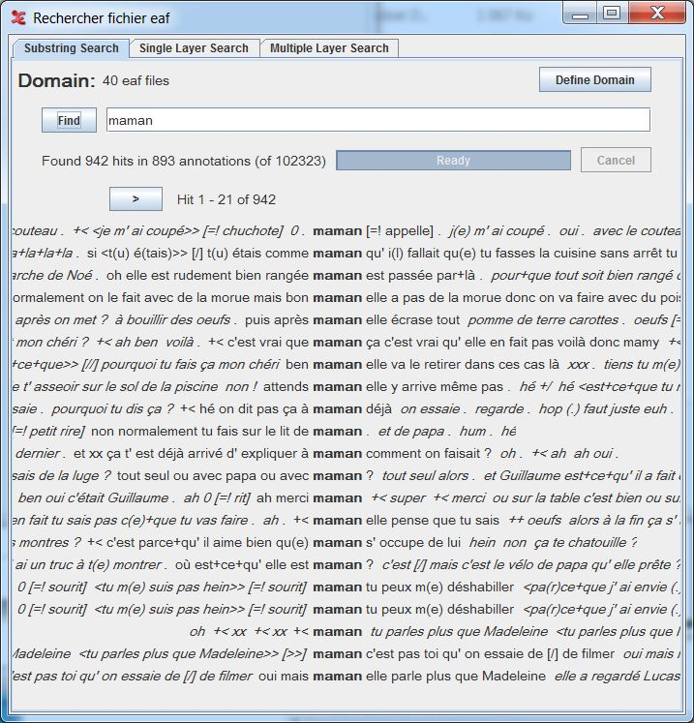
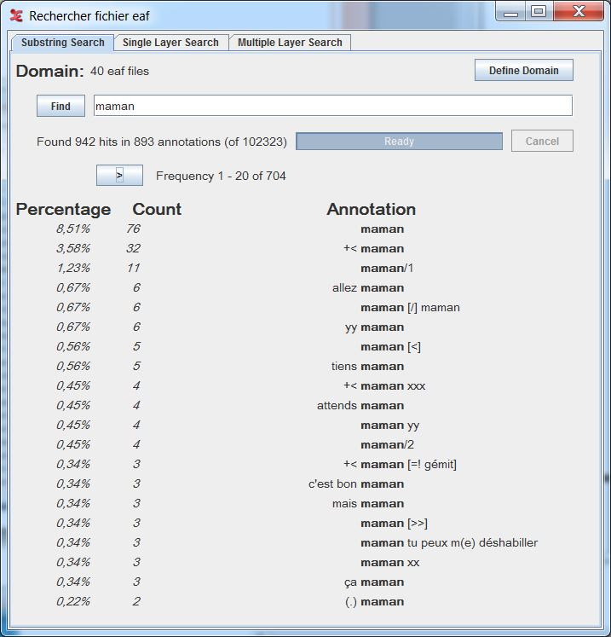
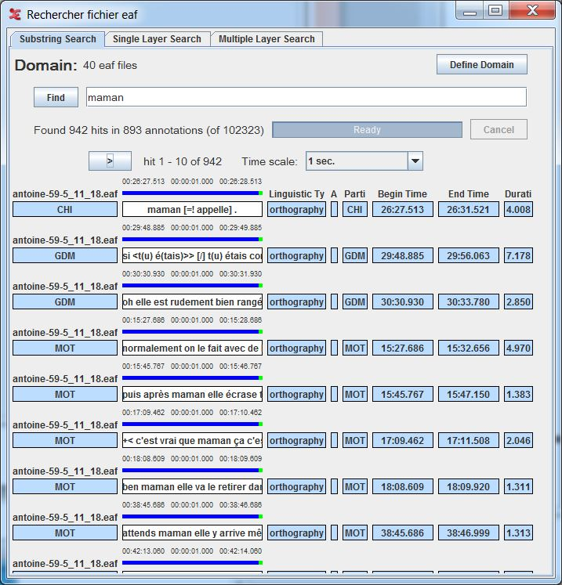
Structured search within many files
Set a search domain
Simple for a single word
3 display formats:
concordancer
frequencies
alignements

Slide 14
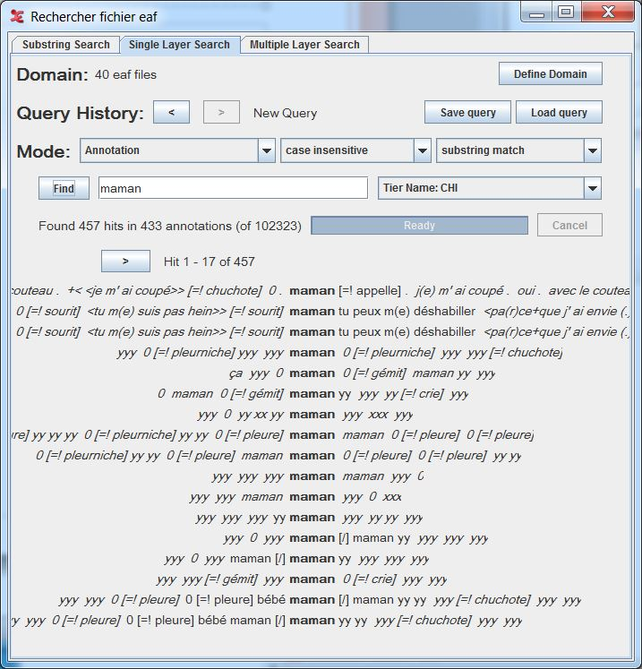
Search and control of the tiers
Use Single Layer Search
Similar other options including tooltips and go to the recording

Slide 15
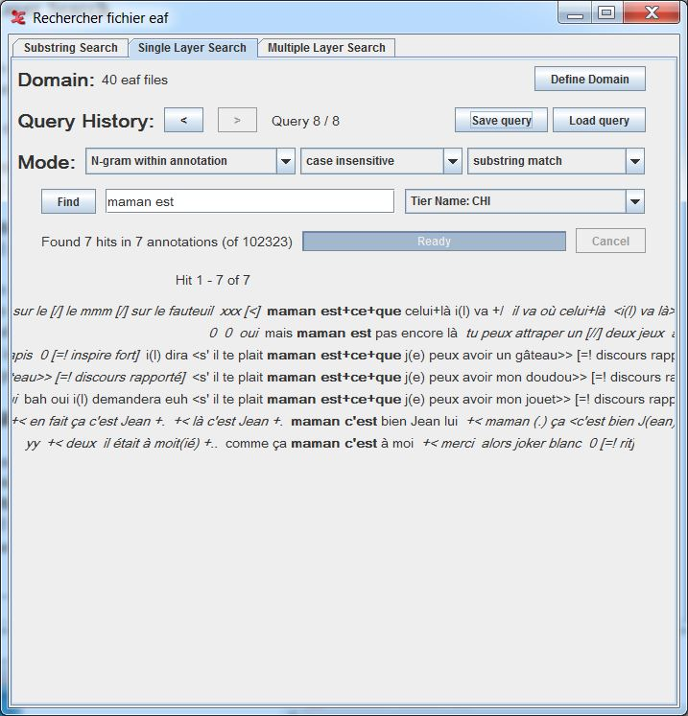
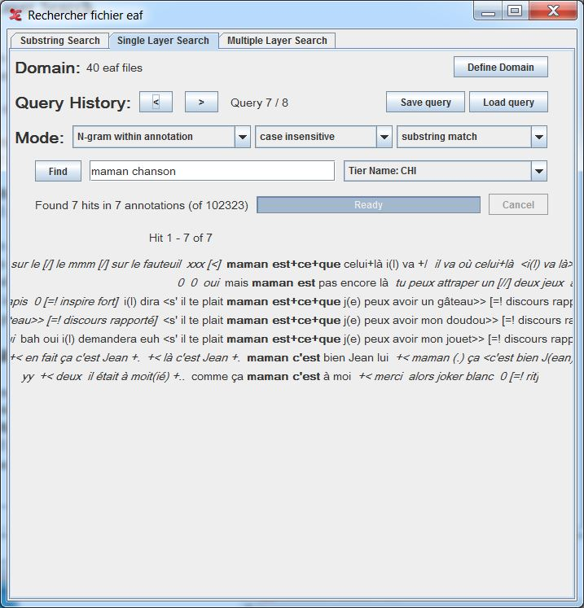
Search for several words
Use the « N-gram over annotation » option
Search for a word that follows another one in several annotation
« Ngram within annotation »
Search for a word that follows another within the same annotation

Slide 16
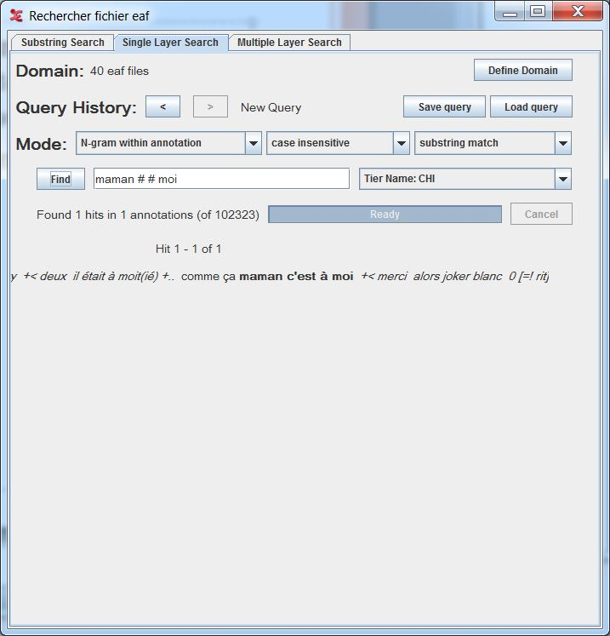
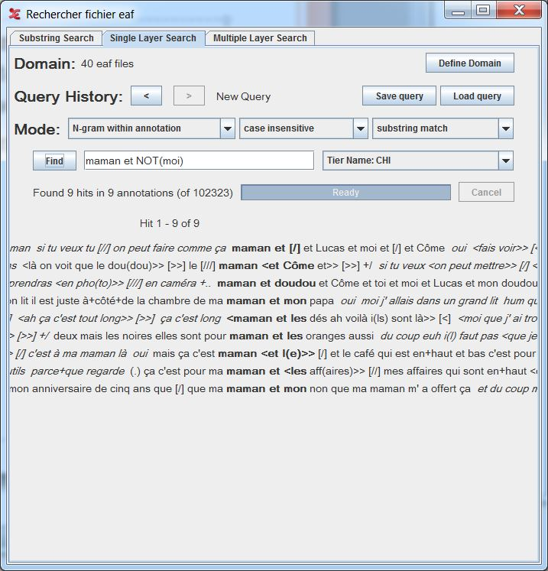
Wild Cards
In n-gram searches, it is possible to use # as a wild card (any word) and NOT(x) to ask for « not the word ‘x’ »
Same system for several utterances

Slide 17
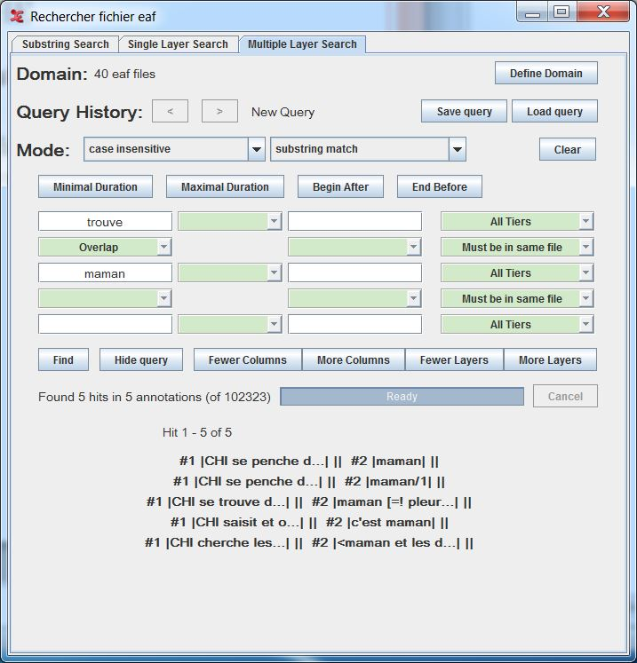
Structured search over multiple files
Several fields are overlapping
example : ‘trouve’ and ‘maman’
Search several strings in multiple annotations and specifying which tiers

Slide 18
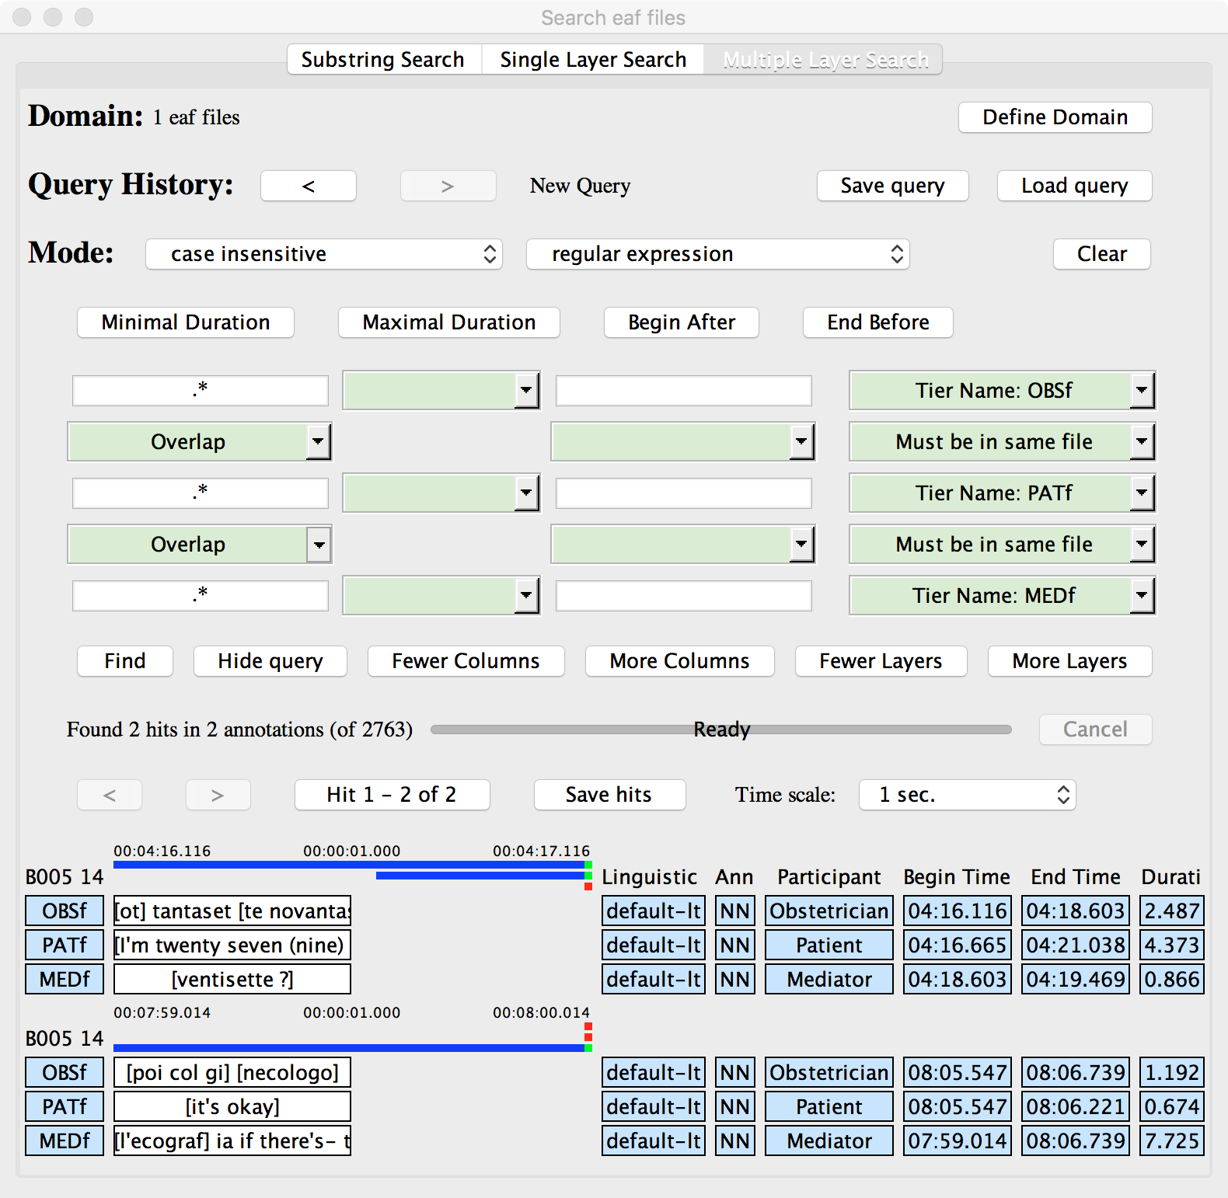
Structured search over multiple files
Three fields are overlapping
Search any string in multiple annotations and specifying which tiers
For any string use regular expression and .*

Slide 19
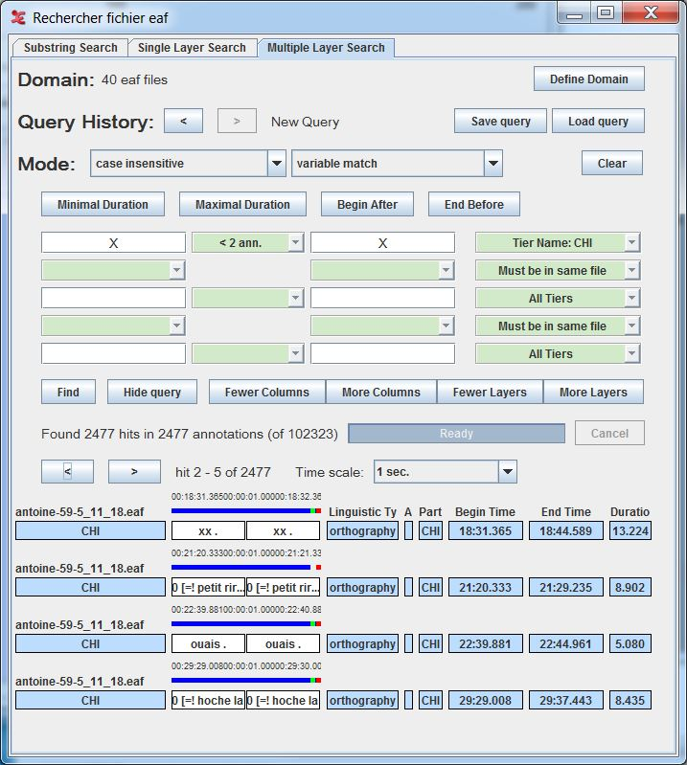
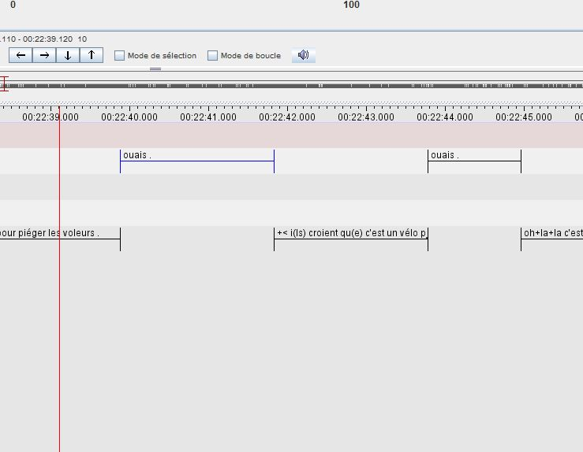
A wide amount of option for searching in well structured annotations
Look for the same pattern if repeated over several utterances

